Slide 1
Inter-thread communication in Java
Inter-thread communication or Co-operation is all about allowing synchronized threads to communicate with each other.
Cooperation (Inter-thread communication) is a mechanism in which a thread is paused running in its critical section and another thread is allowed to enter (or lock) in the same critical section to be executed. It is implemented by following methods of Object class:
wait()
notify()
notifyAll()

Slide 2
wait() method
Causes current thread to release the lock and wait until either another thread invokes the notify() method or the notifyAll() method for this object, or a specified amount of time has elapsed.
The current thread must own this object's monitor, so it must be called from the synchronized method only otherwise it will throw exception.
public final void wait()throws InterruptedException

Slide 3
notify() method
Wakes up a single thread that is waiting on this object's monitor. If any threads are waiting on this object, one of them is chosen to be awakened. The choice is arbitrary and occurs at the discretion of the implementation. Syntax:
public final void notify()
notifyAll() method
Wakes up all threads that are waiting on this object's monitor. Syntax:
public final void notifyAll()

Slide 4
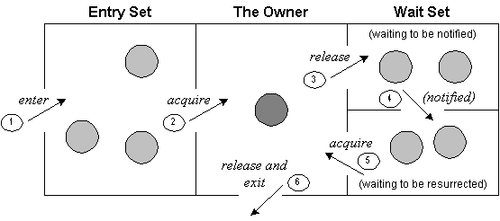
process of inter-thread communication

Slide 5
The point to point explanation of the diagram is as follows:
Threads enter to acquire lock.
Lock is acquired by on thread.
Now thread goes to waiting state if you call wait() method on the object. Otherwise it releases the lock and exits.
If you call notify() or notifyAll() method, thread moves to the notified state (runnable state).
Now thread is available to acquire lock.
After completion of the task, thread releases the lock and exits the monitor state of the object.

Slide 6
Difference between wait and sleep
wait() | sleep()
wait() method releases the lock | sleep() method doesn't release the lock.
is the method of Object class | is the method of Thread class
is the non-static method | is the static method
should be notified by notify() or notifyAll() methods | after the specified amount of time, sleep is completed.

Slide 7
class Customer{
int amount=10000;
synchronized void withdraw(int amount){
System.out.println("going to withdraw...");
if(this.amount<amount){
System.out.println("Less balance; waiting for deposit...");
try{wait();}catch(Exception e){}
}
this.amount-=amount;
System.out.println("withdraw completed...");
}
synchronized void deposit(int amount){
System.out.println("going to deposit...");
this.amount+=amount;
System.out.println("deposit completed... ");
notify();
}
}

Slide 8
class Test
{
public static void main(String args[])
{
final Customer c=new Customer();
new Thread()
{
public void run(){c.withdraw(15000);}
}.start();
new Thread()
{
public void run(){c.deposit(10000);}
}.start();
}
}

Slide 9
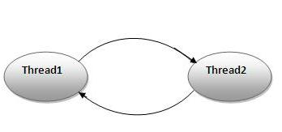
Deadlock in java
Deadlock in java is a part of multithreading. Deadlock can occur in a situation when a thread is waiting for an object lock, that is acquired by another thread and second thread is waiting for an object lock that is acquired by first thread. Since, both threads are waiting for each other to release the lock, the condition is called deadlock.

Slide 10
public class TestDeadlockExample1
{
public static void main(String[] args) {
final String resource1 = "ratan jaiswal";
final String resource2 = "vimal jaiswal";
// t1 tries to lock resource1 then resource2
Thread t1 = new Thread()
{
public void run() {
synchronized (resource1) {
System.out.println("Thread 1: locked resource 1");
try { Thread.sleep(100);} catch (Exception e) {}
synchronized (resource2) {
System.out.println("Thread 1: locked resource 2");
}
}
}
};

Slide 11
// t2 tries to lock resource2 then resource1
Thread t2 = new Thread()
{
public void run() {
synchronized (resource2) {
System.out.println("Thread 2: locked resource 2");
try { Thread.sleep(100);} catch (Exception e) {}
synchronized (resource1) {
System.out.println("Thread 2: locked resource 1");
}
}
}
};
t1.start();
t2.start();
}
}

